Slide 1
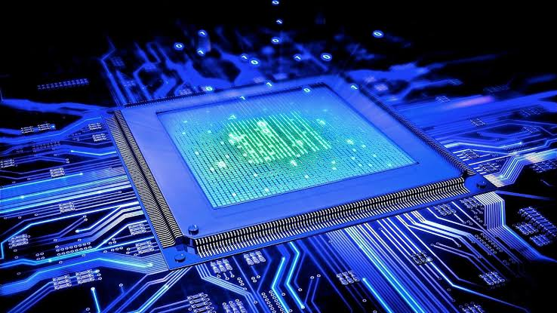
Introduction to Computing
[Brian]
[Henry]
[Wayne]
[Haneef]
[Pendeli]

Slide 2
Meet the team
[Haneef + Wayne] Intro and MP1 PC architecture
[Name 2] MP1 SQL demo, reflection and GAI
[Name 3] MP2 Software engineering
[Brian] MP3 Networking
[Team] MP4 Security,
[Team] conclusion and Q&A

Slide 3
Four mini demos
MP1 Computing: Wayne + Haneef
MP2 Software: Henry
MP3 Networking: Pandeli
MP4 Security: Brian
Reflection and GA:I Team Task
Conclusion: Team Task

Slide 4
MP1: Computing
The problem [What did the client need a computer and a database to do?]
PC architecture [The hardware you chose and why it fits the brief]
SQL database [The tables you designed and what they store]
One decision [A choice you made and the alternative you rejected]

Slide 5
MP1: Computing
The problem [Which security topic did you explain, and for whom?]
Our solution [Your explanation approach and the sources behind it]
One decision [A choice about content or sources, and why]

Slide 6
Mini demo: query live data
Open [Your database, opened from the GitHub repo]
Run [One SELECT query, short enough to explain]
Show [Real, correct rows. Point at one result.]
Backup [Paste a screenshot here, or link your recorded fallback video]

Slide 7
MP2: Software Engineering
The problem [What did Pennine Pizza Works need the program to do?]
Our solution [The program you designed: flowchart, logic, testing]
One decision [A design choice and the alternative you rejected]

Slide 8
Mini demo: run the program
Open [Your Flowgorithm file, opened from the GitHub repo]
Run [A typical order as test input]
Show [The correct output, then one edge case]
Backup [Paste a screenshot here, or link your recorded fallback video]

Slide 9
MP3: Networking
The problem [What did the studio need from its network?]
Our solution [Your layout: devices, addressing and services]
One decision [A design choice and the alternative you rejected]

Slide 10
Mini demo: ping the network
Open [Your Filius simulation, opened from the GitHub repo]
Run [A ping or browser request: from which machine to which]
Show [A successful reply across the network]
Backup [Paste a screenshot here, or link your recorded fallback video]

Slide 11
MP4: Cyber Security
The problem [Which security topic did you explain, and for whom?]
Our solution [Your explanation approach and the sources behind it]
One decision [A choice about content or sources, and why]

Slide 12
Mini demo: MFA
Open [Your awareness piece, opened from the GitHub repo]
Read [Your strongest explanation, about 30 seconds]
Point [One reference, and why it is a good source]
Backup [Paste a screenshot here, or link your recorded fallback video]

Slide 13
What links the four projects
How they connect [One sentence linking computing, software, networking and security]
What went well [One thing the team is proud of]
What was hard or unfinished [Be honest: one challenge and what you would fix next]
What we learned [One lesson across all four projects]

Slide 14
How we used and checked GAI
MP1 [Tool and task] → [How we checked or corrected it]
MP2 [Tool and task] → [How we checked or corrected it]
MP3 [Tool and task] → [How we checked or corrected it]
MP4 Not used → during our research we avoided using AI
Notes:
MP1
MP2
MP3
MP4: we didnt use any AI when doing our cyber security research, this is because we needed to source all of our information and I dont think AI can reliably source totally accurate / reliable information since it the client brief specifically asked to use Harvard referencing and to also

Slide 15
Conclusion and questions ?
Takeaway overall, we as a team believe that we could of communicated better
Q&A does anyone have questions
Notes:
Communication between was poor, for example haneef struggled to do his allocated work multiple times and didn't inform any of the team
evidencing could of been done a lot better, the github repository could of been used a lot better and wasn't utilised as well as it could of been

